Slide 1
MULTI-CONTROLLER IN SOFTWARE DEFINED NETWORKING: A STUDY
Guided by
N.Rana Singha
Presented by
Rajakuddin Ahmed
CS15MI0381

Slide 2
Contents
Introduction
Why SDN?
What is SDN?
Architecture of SDN
Controller
Single centralized controller
Multi-controller
Objective
Literature review
Comparative study
Software/hardware requirements
Future work
Conclusion

Slide 3
Introduction
The Internet has been identified as an essential infrastructure that supports social development and technological progress in the past 30 years, and it has profoundly changed the people’s working, studying and living styles. However, traditional network technology has inherent defects of rigid structure and complex configuration and cannot meet the requirement of network innovation . Thus, it is deemed urgent to design and develop a new network architecture that can dynamically and flexibly manage the network . Software-Defined Networking (SDN) is proposed to overcome the aforementioned weaknesses of the traditional network.

Slide 4
Why SDN ?
Before moving to SDN first we have to understand about the traditional network architecture. The traditional network architecture is mainly made up of network devices such as routers and switches. These devices have integrated software and hardware where the hardware (data plane) responsible for simple packet forwarding and software (control plane) is responsible for setting the forwarding routes to the data plane. We can say that the control plane works like brain for the device. These devices are extremely intelligent because they have their own little brains which is the control plane,

Slide 5
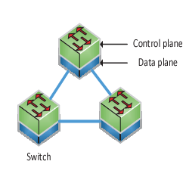
with the help of control plane the devices communicates with other devices and they extract the best possible paths and then provide the best path to the data plane, after getting the routes the data plane perform the forwarding function.

Slide 6
Since every device is intelligent so they have to be configured and managed individually. When a network scales its configuration increases, its complexity increases, management also increases .For a huge network having thousands of devices the configuration need to be done individually on per device basis which could be really painful.
Some problems of the traditional networks are;
Cost is high
Complexity in configuration and management of the network devices
Devices are function specific
To o overcome from the problems, the need for developing and deploying a new network architecture have raised. That’s why development and deployment of SDN was done.

Slide 7
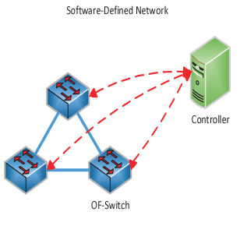
What is SDN?
Software defined networking is a network framework that involves in the separation of control function with the data forwarding function. Which make the devices, simple packet forwarding device and take brains away from the network devices which mean taking the control plane away from all the network devices and put then them together in a centralized point.

Slide 8
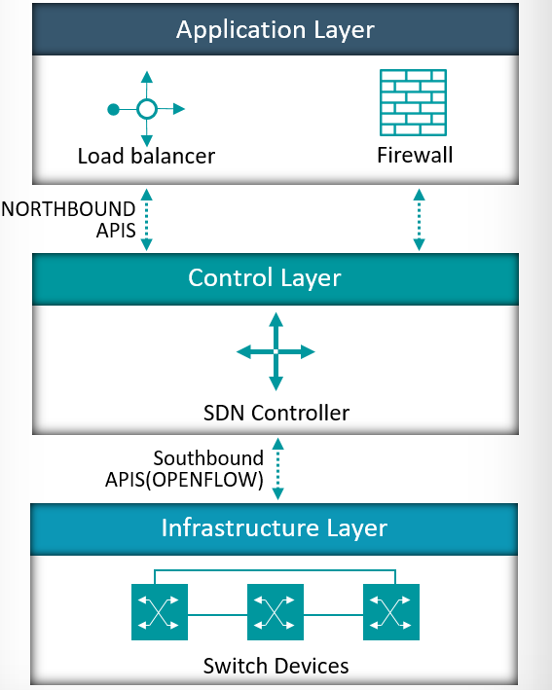
Architecture of SDN
SDN architecture comprises of three layers and they are data plane, control plane and application plane.

Slide 9
Controller
Controllers are also referred to as the brains in a SDN network. Controllers act as a control point for the networks to manage the flow between the application plane and data plane in order to create a more flexible network

Slide 10
Single centralized controller
The single centralized controller manages the network from a centralized point. As the network size increases, a single centralized controller cannot meet the growing demand for flow processing because of the limited capacity controller which leads to degradation in the performance, there is also a single point of failure for a single centralized controller. If a controller fails then the network devices in the network won’t be able to get forwarding routes which may create an inconsistency in the networking. Thus, the promising solution for SDN with large scale organizations is the Multi-controller.

Slide 11
Multi-controller
Multi-controller design can divide the entire network into several domains, and each controller manages its own SDN domain. To make sure that packets are transmitted correctly in the network, the controllers must interact the domain information with each other to keep the consistent view. This Multi-controller approach avoids having a SPOF and enables to scale up sharing load among several controllers.

Slide 12
Objective:
In this paper, our main objective is to solve the multi-controller scalability issue. Initially we will implement the multi-controller model which was given by “Amin Tootoonchian, Yashar Ganjali” in their paper“HyperFlow: A Distributed Control Plane for OpenFlow” and perform scalability testing by generating traffic on their model and then provide a new multi-controller model which will be more scalable than the HyperFlow model.

Slide 13
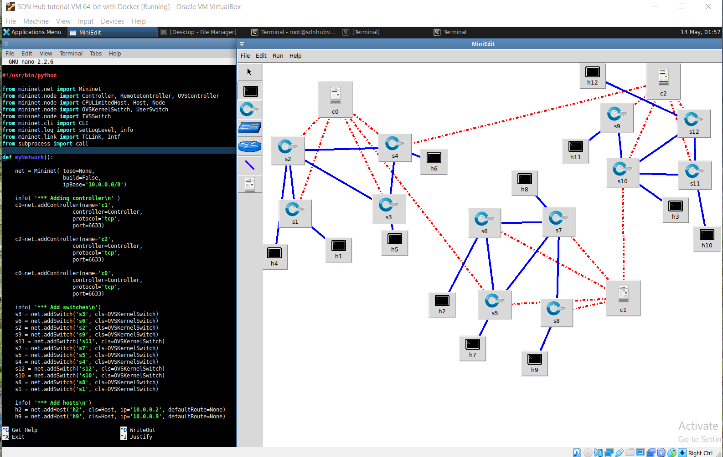
HyperFlow model

Slide 14
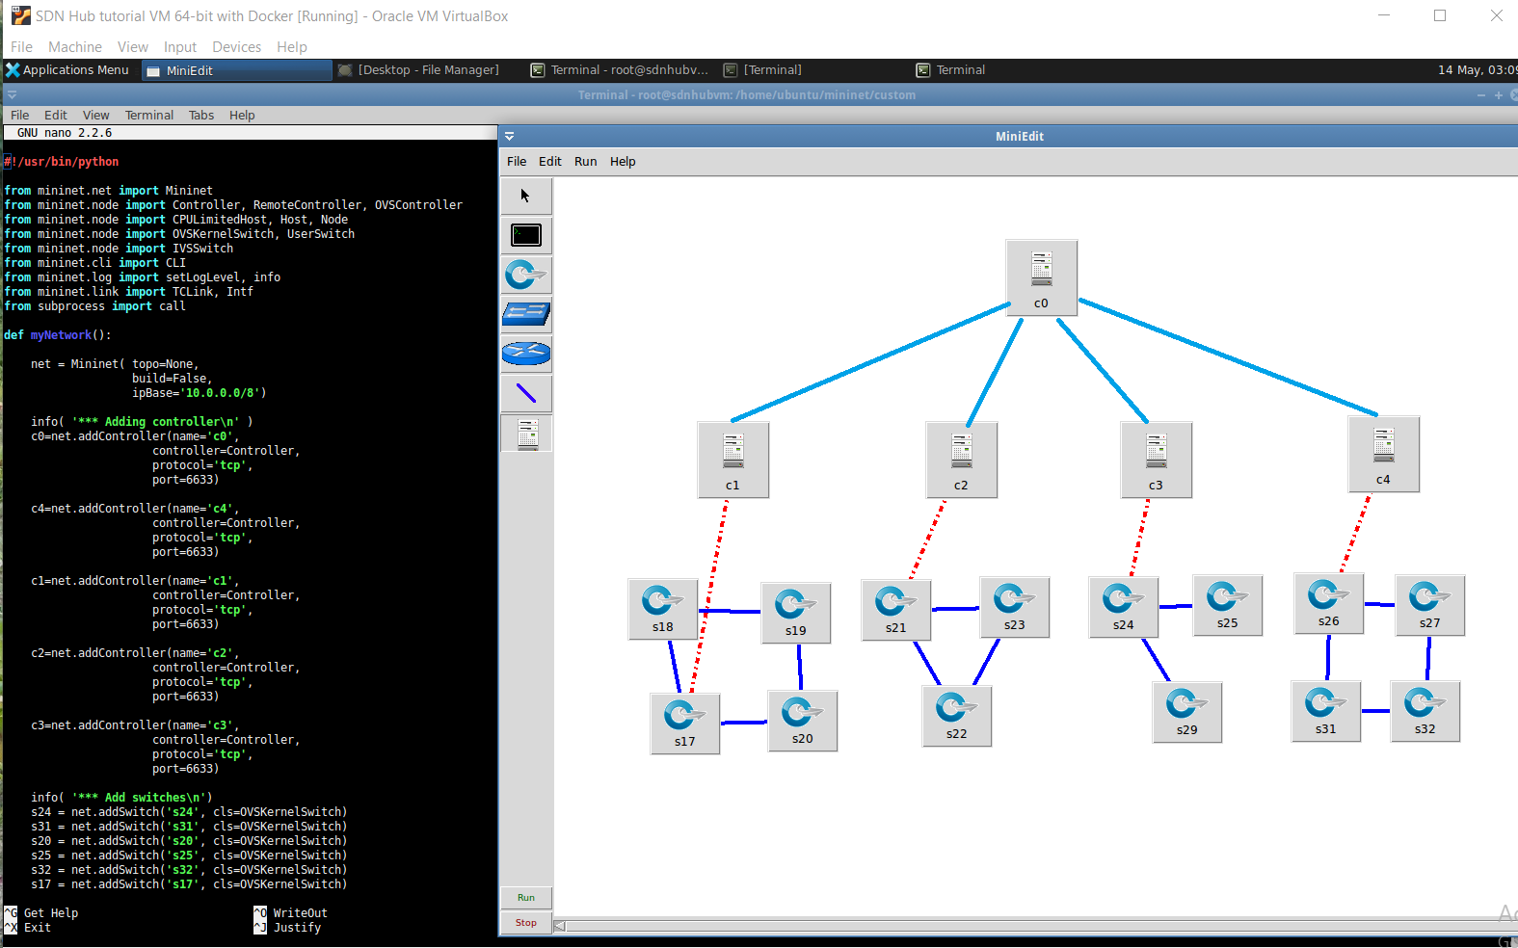
Proposed Model

Slide 15
Literature Review
Literature Review
Title : Multi-Controller Based Software-Defined Networking : A Survey
Author : Zehua Guo, Peng Yi, Tao Hu, Julong Lan
Publication : National Digital Switching System System Engineering and Technological Research 12 March 2019
Objective : Software-Defined Networking (SDN) is a novel network paradigm that enables flexible management for networks. As the network size increases, the single centralized controller cannot meet the increasing demand for flow processing. Thus, the promising solution for SDN with large-scale networks is the multi-controller. In this paper, we present a compressive survey for multi-controller research in SDN. First, we introduce the overview of multi-controller, including the origin of multi-controller and its challenges. Then, we classify multi-controller research into four aspects depending on the process of implementing the multi-controller. Finally, we propose some relevant research issues to deal with in the future and conclude the multi-controller research

Slide 16
Literature Review
Title : An Overview of Multi-Controller Architecture in Software-Defined Networking
Author : Amir Hossein Moravejosharieh, Michael j watts, Kourosh Ahmadi
Publication : National Digital Switching System System Engineering and Technological Research
Objective : Software-Defined Networking (SDN) is a rapidly growing and widely accepted networking paradigm that provides greater flexibility in network management. This is mainly achieved due to the separation of the control plane and data plane. In an SDN-enabled network, a centralized controller receives the high-level network application requirements, translates them into low-level commands to be instructed on forwarding devices. Such a controller has a limited capacity to respond to flow processing requests issued by forwarding devices. As the size of an SDN-enabled network or the amount of network traffic become larger, a single centralized controller may not be able to handle requests for flow processing which results in controller performance degradation and eventually dysfunctional SDN-enabled network. A practical solution would be the deployment of multi-controller architecture where a group of controllers collaboratively handle a massive amount of network traffic and flow processing requests. The major contribution of this paper is to provide an overview of the multi-controller architecture, its challenges in terms of reliability, scalability, coherence and availability, and also highlighting future research areas in this domain .

Slide 17
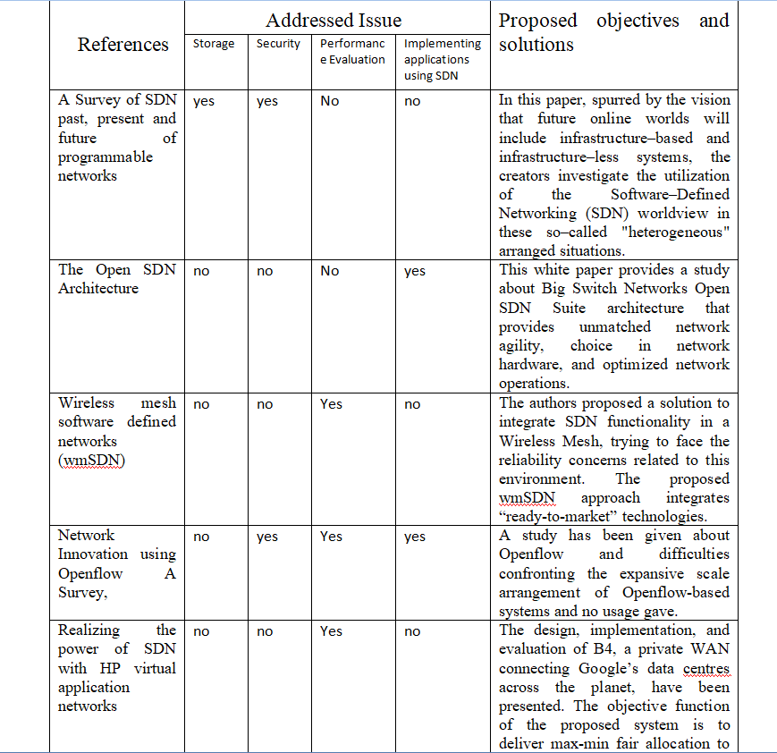
Comparative study

Slide 18
Software/hardware requirements
Oracle VM VirtualBox
Ubuntu (64 bit)
Mininet
Miniedit
Java
Python

Slide 19
Conclusion
The design and performance of the control plane are the critical part of SDN. In order to achieve the large-scale application of SDN, the control plane has evolved from the single centralized controller to multiple controllers. In this paper, based on the existing literature, we first provide an overview of multi-controller, including the origin of multi-controller. Then, we summarize the main research challenge of multi-controller: scalability. Meanwhile, we also consider the corresponding solution for the scalability issue.

Slide 20
Future expression
In future we need to perform some scalability test over the Hyper-flow model, after that we also needed to perform some test over the given new hierarchical model to check for the scalability of the new model.

Slide 21
Thank You

